Slide 1

CMR COLLEGE OF ENGINEERING & TECHNOLOGY
Kandlakoya, Medchal, Hyderabad - 501401
Department of Computer Science and Engineering
Classification Of Bone Fractures using CNN
Batch No:78
Name of the student & Roll.No.
N.Aeyba 21H55A0516
S.Sushma 21H55A0520
S.Laxmi Narayana 21H55A0523
Under esteemed guidance of
Ms. P.Navyasree
(Assistant Professor)

Slide 2
Outline
Abstract
Introduction
Literature survey
Existing system
- Problems in existing system
Research Objective of Presentation
Problem Definition
Research work
- Proposed system architecture
- Methods
- Comparison of Proposed system with an existing system
Performance Measure
Results
Conclusion
Future Work
References
Notes:
2

Slide 3
Abstract
Notes:
3

Slide 4
ABSTRACT
In recent years, bone fracture detection and classification has been a widely discussed topic and many researchers have proposed different methods to tackle this problem. Despite this, a universal approach able to classify all the fractures in the human body has not yet been defined. We aim to analyze and evaluate a selection of papers, chosen according to their representative approach, where the authors applied different deep learning techniques to classify bone fractures, in order to select the strengths of each of them and try to delineate a generalized strategy. In recent years, deep learning and, in particular, the convolution neural network (CNN), has achieved results comparable to those of humans in bone fracture classification.

Slide 5
INTRODUCTION
Notes:
5

Slide 6
Introduction
Since long ago, bone fractures was a long standing issue for mankind, and it's classification via x-ray has always depended on human diagnostics – which may be sometimes flawed. In recent years, Machine learning and AI based solutions have become an integral part of our lives, in all aspects, as well as in the medical field. In the scope of our research and project, we have been studying this issue of classification and have been trying, based on previous attempts and researches, to develop and fine tune a feasible solution for the medical field in terms of identification and classification of various bone fractures, using CNN ( Convolutional Neural Networks ) in the scope of modern models, such as ResNet, DenseNet, VGG16, and so forth. After performing multiple model fine tuning attempts for various models, we have achieved classification results lower then the predefined threshold of confidence agreed upon later in this research, but with the promising results we did achieve
Notes:
6

Slide 7
Literature Survey
Notes:
7

Slide 8
Existing system
Classification with Deep Learning Models:
Various research studies and projects have utilized CNNs and other deep learning architectures for bone fracture classification. These models typically involve training on large datasets of medical images to classify different types of fractures.
Dataset Creation:
Creating a large and diverse dataset of medical images is crucial for training effective fracture classification models. These datasets may include X-ray, CT scans, or MRI images of fractures from different body parts and angles.
Commercial Systems and Medical Devices:
Some companies and medical device manufacturers have developed commercial systems or software applications for bone fracture classification. These systems may incorporate CNNs and other machine learning techniques to assist radiologists and clinicians in diagnosing fractures accurately
Notes:
8

Slide 9
Research Objective
Notes:
9

Slide 10
Research objective
After loading all the images into data frames and assigning a label to each image, we split our images into 72% training, 18% validation and 10% test. The algorithm starts with data augmentation and pre-processing the x-ray images, such as flip horizontal. The second step uses a ResNet50 neural network to classify the type of bone in the image. Once the bone type has been predicted, A specific model will be loaded for that bone type prediction from 3 different types that were each trained to identify a fracture in another bone type and used to detect whether the bone is fractured. The algorithm can determine whether the prediction should be considered a positive result, indicating that a bone fracture is present, or a negative result, indicating that no bone fracture is present. The results of the bone type classification and bone fracture detection will be displayed to the user in the application, allowing for easy interpretation.

Slide 11
Problem Definition
Notes:
11

Slide 12
Problem Definition
The algorithm starts with data augmentation and pre-processing the x-ray images, such as flip horizontal. The second step uses a ResNet50 neural network to classify the type of bone in the image. Once the bone type has been predicted, A specific model will be loaded for that bone type prediction from 3 different types that were each trained to identify a fracture in another bone type and used to detect whether the bone is fractured. This approach utilizes the strong image classification capabilities of ResNet50 to identify the type of bone and then employs a specific model for each bone to determine if there is a fracture present.

Slide 13
Research Work
Notes:
13

Slide 14
Proposed Methods
S.No | Authors and Journal Name& Year of publication | Problem Statement | Name of the Proposed solution/Method | Solution | Remarks
1 | D.P Yadav,Sandeep Rathor (2020) | Bone Fracture Detection & Classification using Deep Learning Approach | Deep Neural Network(DNN) | Deep Neural Network(DNN) is used for classification and fracture detection in fractured and healthy bones. | Less Accuracy.
2 | Leonardo Tanzi,Rodrigo Moreno,Sandro Moos,Enrico Vezzetti (2020) | Bone Fracture classification Using Deep Learning | Neural Network | Classification Of Bone Fractures,CAD system | Limited record are added.
3 | Tripathi,Ankur Mani,etal (2017) | Automatic Detection of fractures in femur bones using Image Processing | Paper proposed to visualize and classify deformities for locating fractures in the femur through image processing technique | In this approach the classification of fractured and unfractured bone is done with the help of prepocessing,fracture extraction & classification of image processing techniques. | Fracture is detected only for femur bones.
4 | Dimililer, kamil (2017) | Intelligent Bone Fracture Detection System | Neural Network | The Author did not focus on a specifictype of bone,instead the dataset is composed of various body parts. | The tool was trained with 30 images and tested with 70 images.

Slide 15
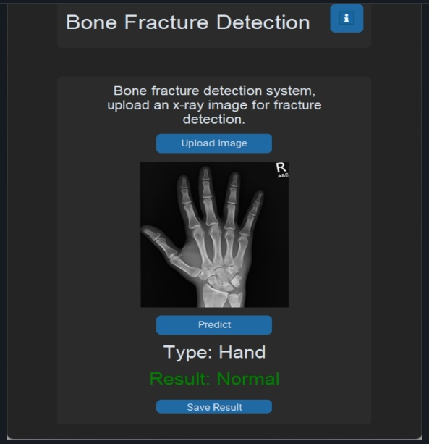
Result Analysis
We Present the outcomes of our Machine Learning model.
We are trying to evaluate its efficiency.
We Compare its performance with traditional methods and existing methods.

Slide 16
Conclusion
The algorithm can determine whether the prediction should be considered a positive result, indicating that a bone fracture is present, or a negative result, indicating that no bone fracture is present. The results of the bone type classification and bone fracture detection will be displayed to the user in the application, allowing for easy interpretation. This algorithm has the potential to greatly aid medical professionals in detecting bone fractures and improving patient diagnosis and treatment. Its efficient and accurate analysis of x-ray images can speed up the diagnosis process and help patients receive appropriate care.

Slide 17
Future work
Some future improvements can be made to this project. To improve the accuracy, a dataset with more number of images can be given.
The algorithm can be improved to an extent where it can be able to process and give the desired result on images without disturbances like lack of clarity, a different angle.
Right now, the computer just says whether there's a fracture or not. It would be helpful if it could also point out exactly where the fracture is and why it thinks so.
Conduct extensive clinical validation studies to assess the performance, reliability, and safety of CNN-based fracture classification systems in real-world healthcare.
Explore the integration of multiple imaging modalities such as X-ray, CT, MRI, and ultrasound for more comprehensive fracture classification.

Slide 18
References
[1] Mahendran, S. K., & Baboo, S. S. (2011). Automatic fracture detection using classifiers-a review. International Journal of Computer Science Issues (IJCSI), 8(6), 340.
[2] Johari, N., & Singh, N. (2018). Bone fracture detection using edge detection technique. In Soft Computing: Theories and Applications: Proceedings of SoCTA 2016, Volume 2 (pp. 11-19). Springer Singapore.
[3] Paulano, F., Jiménez, J. J., & Pulido, R. (2014). 3D segmentation and labeling of fractured bone from CT images.The Visual Computer, 30, 939-948.
[4] Aishwariya, R., Geetha, M. K., & Archana, M. (2013).Computer-aided fracture detection of x-ray images. IOSR Journal of Computer Engineering, 2278-2661.
[5] Kaur, H., & Jain, A. (2017). Detection of Fractures in Orthopedic X-Ray Images. International Journal of Advanced Research in Computer Science, 8(3).

Slide 19
Thank You!

